Slide 1
Transducers
Resistive Transducers: In terms of physical quantities, the equation for electrical resistance of a metal conductor is given by R = ρ l/ A where R is the resistance (ohms), ρ is the conductor resistivity or specific resistance (ohm cm), l is the physical length (cm) and A is the uniform cross sectional area of the resistor (cm²). Any method of varying one of these quantities can be the design basis of an electrical transducer. In the variable resistance transducer, an indication of measured physical quantity is given by a change in the resistance. Resistive transducers could be :
Mechanically varied resistance (potentiometer)
Thermal resistance change (resistance thermometers)
Resistivity change (resistance strain gauge)
Further, with some devices resistance changes with light intensity (photo conductive effect) while with others the resistance changes on exposure to magnetic field (magneto resistive effect).
The variable resistance transducers are active, and they rely on an external excitation voltage for their operation. However, they are straight forward in design, simple and easy to use.

Slide 2
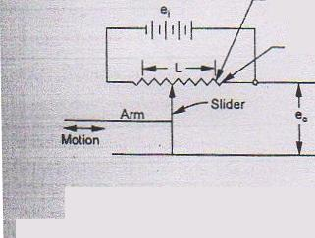
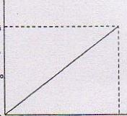
Transducers
Linear and angular motion potentiometers : These potentiometers convert the linear motion (or the angular motion of a rotating shaft)-into-changes in-resistance.. Basically a resistive potentiometer (or `pot'.) is a variable resistor whose resistance is varied by the movement of a slider over a resistance element. (Fig 4.2, a. b). Translatory devices have strokes from 2 mm to 50 cm, while rotational ones have a full scale ranging from 10° to as much 60 full turns. 4.2.(a).Linear motion potentiometer schematics

Slide 3
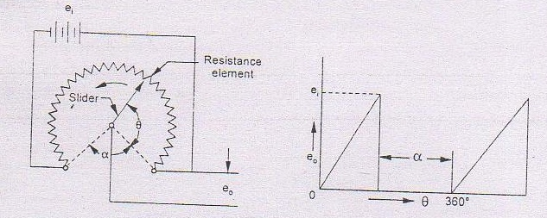
Transducers
The resistance elements in common use are wire wound because that gives sufficiently high resistance value in small space.
Fig. 4.2 (b) Rotary motion potentiometer schematics

Slide 4
Transducers
Typical single turn wire-wound pots are 5 cm in diameter, have a power rating up to 5 W and a total resistance between 100 Ω and 100 k Ω . The potentiometer forms a part of a bridge circuit whose output voltage is altered by the position of the slider. The output voltage is a linear function of the input displacement, i.e., travel of the sliding arm (wiper) provided the measuring device has a resistance much greater than the potentiometric resistance. The input excitation voltage is limited by the dissipating wattage which causes the temperature of the winding wire to rise to a specified level. This voltage level depends upon the cooling conditions, the thermal characteristics of the potentiometer wire, the transducer housing design, and is generally prescribed by the relation.
Vs =

Slide 5
Transducers
where Vs is the maximum source voltage, P is the maximum power dissipation and Rm is the total resistance of fine wires of the potentiometer winding.
With both the linear and rotary displacement potentiometers, the slider is powered by the mechanical pan on which the linear displacement (or angular motion) measurements are to be made. On account of the arm movement, the slider moves over the resistance element and thus shorts out a portion of the resistance. The resistance change in the potentiometer is then an indication of the amount of motion and the direction of movement is indicated by whether the resistance is increasing or decreasing. The unbalanced voltage is measured directly or fed into an amplifier and recorded.

Slide 6
Transducers
For a linear potentiometer, the theoretical relationship between the output potential difference and the displacement of the slider is a straight line graph passing through the origin. However, in practical applications, a deviation is expected from the straight line relationship, and the maximum deviation from the straight line expressed as a percentage of full output potential difference is referred to as linearity.
Consider a potentiometer which shows a maximum deviation of 0.05 volt from the straight line. If maximum output potential difference is 10 V, then
absolute linearity =0.05/10 or 0.5%
The linearity is largely dependent on the uniformity of resistance.
Applications : The potentiometers find application in many transducers designed to measure pressure, force, acceleration and liquid level.

Slide 7
Transducers
Advantages : -Such transducers have the advantages of
availability in different sizes, shapes and ranges
less expensive and high output
a-c excitation
rugged construction, insensitivity towards vibration and temperature.
Disadvantages : The device has a limited life due to early wear of the sliding arm. Under normal operating conditions, the life of a pot may be more than 20 million full strokes or rotations. The output tends to be noisy and erratic in high speed operation or when used in high vibration environment. Experience shows that the noise problem tends to become troublesome when the sliding velocity exceeds 3 m/s.

Slide 8
Transducers
Example A 4 cm long linear resistance potentiometer is uniformly wound with a wire having a resistance 8000 ohm. Under normal conditions, the slider is positioned at the centre of the potentiometer. During operation, the slider moves over the resistance element, and resistance of the potentiometer as measured by a wheat stone bridge is (i) 3200 ohm and (ii) 6000 ohm. Find the linear displacement and comment on the direction of the two displacements.
Solution : At normal position, the slider is at the centre of the potentiometer and accordingly its resistance is equal to 8000/2 = 4000 ohm.
Resistance of wire per unit length = 8000/4 =2000 ohm
(i) change in resistance of potentiometer from its normal position
= 4000 — 3200 = 800 ohm
.•. Displacement = 800/2000 = 0.4 cm
(ii) change in resistance of potentiometer from its normal position
= 6000 — 4000 = 2000 ohm
Displacement = 2000/2000 = 1 cm
One of the displacements represents a decrease and the other represents an increase

Slide 9
Transducers
Advantages of Resistance Potentiometers:
1. They are inexpensive
2. Simple to operate and very useful for applications where requirement is not severe
3. Useful for measuring large amplitudes of displacement.
4. Electrical efficiency is very high and they provide sufficient ouput to permit control operations without further amplifications
5. Although, the frequency response of wire wound potentiometers is limited, the other types of potentiometrs are free from this problem.
Disadvantages: 1. They require a large force to move their sliding contacts
2. The sliding contacts can wear out, become misaligned and generate noise. So, life of the transducer is limited.

Slide 10
Transducers
in resistance of the potentiometer when compared with the potentiometer resistance wider normal conditions. This difference points out that the two displacements are in opposite direction.
Resistance Thermometers: To be covered in Unit IV
Resistance Strain gauges- To be covered in Unit IV
Inductive Transducers: These transducers are based on a change in the magnetic characteristics of an electrical circuit in response to a measurand which may be displacement, velocity, acceleration etc. Before discussing these transducers, it is pertinent to become familiar with the following terms and definitions :
Inductance or self-inductance : When a varying current is made to pass through a coil, an induced counter emf results due to magnetic flux intersecting the turns of the coil. This effect causes resistance to flow of current and is called inductance or self-inductance.

Slide 11
Transducers
Mutual inductance : The term refers to the set up of an emf in a coil or in a circuit element due to varying flux field in neighbouring coil or circuit element
Reluctance : The term refers to that characteristic of a magnetic circuit which determines the total magnetic flux when a given magneto motive force is applied. Reciprocal of reluctance is termed permeance.
Permeability : It is defined as the ratio of the number of flux lines set up in a coil under given conditions to the number of magnetic flux lines that would occur if the path were air (other conditions remaining unchanged).
Variable inductance transducers have the advantage of freedom from mechanical hysteresis, good response to both static and dynamic measurements, continuous resolution and high output. The performance is, however, adversely affected by external magnetic fields.
Variable inductance transducers can be classified into self-generating and passive units.

Slide 12
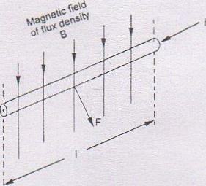
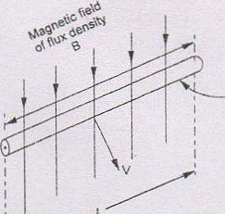
Transducers
4.10.1 Self-generating units in which the output signal is generated because of the relative motion between a conductor and magnetic field, and without the supply of an energy from an external source. The operation of self-generating (active) inductance transducers depends upon the following well-known principles :
(i) When a conductor is caused to move with a velocity through a magnetic field in a plane perpendicular to the magnetic field, then an emf is generated along (the conductor (Fig 4.4a).

Slide 13
Transducers
The relationship between the emf generated and the velocity is given by : e = BlV where e is the generated emf, B is the flux density of the magnetic field, l is the-conductor length and V is the conductor velocity. Evidently when B and l are maintained constant, e is proportional to V. The emf generated along the conductor is then a measure of the velocity of the conductor. Transducers based upon this principle can be used for measuring velocities and are frequently used in measurement of angular speed, vibration and fluid flow.
(ii) When a conductor is placed in a magnetic field with its longitudinal axis at right angles to the lines of flux and a current is allowed to flow through the conductor, then a mechanical force: is generated. This force acts on the conductor in a direction perpendicular to the lines of flux and to the conductor (Fig 4.4 b). The relationship between the force generated and the current is given by
F=Bil

Slide 14
Transducers
where F is the generated force, B is the flux density of the magnetic field, l is the conductor length and is the conductor current. Evidently when B and l are maintained constant, then F is proportional to i. The force generated is then a measure of the current flowing through the conductor. This aspect forms the basis for the working of most of the moving-coil and moving-magnet, type measuring instruments.
Some examples of the self-generating inductive transducers are shown in Fig. 4.5.
In the electromagnetic type, a coil is wound direct on a permanent core. When a plate of iron or other ferromagnetic material is moved with respect to the magnet, the flux field expands or collapses and a voltage is induced in the coil. Practical application of the device lies in the angular speed indication. When the pickup is placed near the teeth of a rotating gear, gear measurements can be made with great accuracy.

Slide 15
Transducers

Slide 16
Transducers
In the electrodynamic type, there is movement of the coil or conductor within the field of a permanent magnet. The turns of the coil are perpendicular to the intersecting lines of force. The movement of the coil induces a voltage which at any moment is proportional to the velocity of the coil. The principle of electrodynamic transducers is used in the magnetic flow meters.
Passive units: In these units the motion of an object results in a change in the inductance of the coils of the transducer ; energy is required to be supplied from an external source.
Passive type inductance transducers operate on the following aspects of flux linkage : (i) When a current i (amperes) passes through a coil having N turns and an air core (Fig 4.6), then a magnetic flux ø (Weber) is generated:
Ø is proportional to Ni or Ni = S Ø where s is called the reluctance of the coil. The reluctance is also prescribed by relation

Slide 17
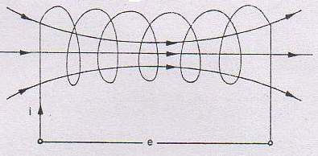
Transducers
where A= corss-sectional area of magnetic circuit (m²)
l = length of magnetic circuit (m)
µ₀ = permeability of free space = 4𝜋 x 10⁻¹ H/m
µ_{r} = relatively permeability of the core of the coil. The value of µ_{r} depends upon the core material, and for air µ_{r}= 1.
Magnetic flux ø , turns N

Slide 18
Transducers
(ii) The coil inductance is a measure of the magnitude of magnetic flux and is defined as
where ø is the magnetic flux density. Combining equations 4.5, 4.6 and 4.7, we obtain
henrys
Evidently the self-inductance of the coil is dependent upon the number of turns of the coil, the geometrical configuration of the circuit and the permeability of the core.
Variable inductance/reluctance transducers are constituted of magnetic field and core such that a gap exists between the core and the fixed coils. A change in the reluctance of the magnetic circuit by a mechanical input results in a similar change both in the inductance and inductive reactance of the coils. The change in inductance is then measured by suitable circuitry and related and to the value of mechanical input
Reluctance of the magnetic circuit may be altered by affecting a change either in the

Slide 19
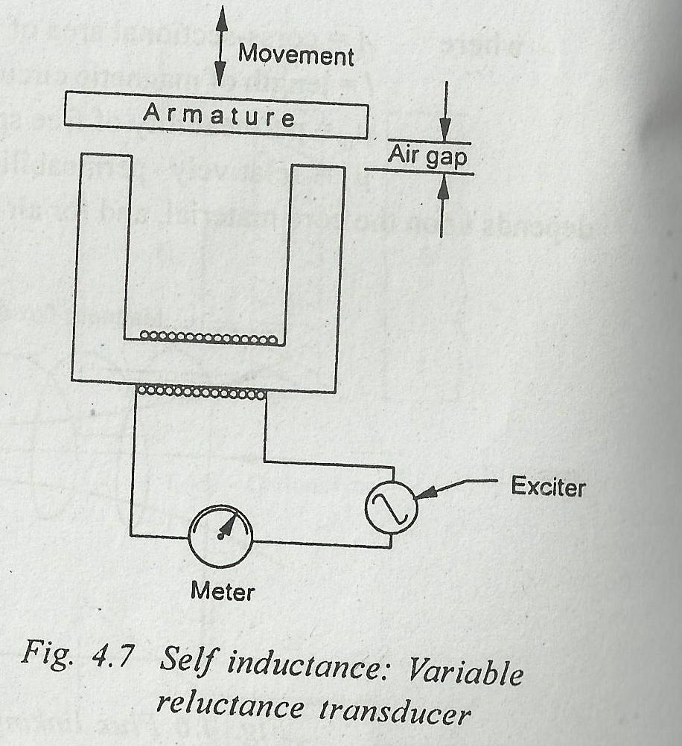
Transducers
air gap or in the amount/type of the core material. Transducers that make use of an air gap change are known as reluctance type and the transducers utilizing a variable core permeability change are referred to as permeance type.
Variable reluctance transducer : Fig 4.7 shows the variable reluctance transducer in which the variable air gap serves to alter the inductance of a single coil. The change in inductance may be calibrated in terms of the armature movement. The variable reluctance principle is particularly applicable to measurement of dynamic quatvities such as pressure, acceleration, force, displacement and angular position etc.

Slide 20
Transducers
Example 4.3 In a variable-reluctance transducer of the type shown in Fig. 4.7, the coil has an inductance of 1950 µH when the armature is 1 mm away from the core. The armature is given a displacement of 0.025 mm in a direction moving it towards the core. Calculate the changed inductance and comment upon the proportionality between the change in inductance and the armature displacement.
Solution : Air gap after displacement of the armature
= 1.00 — 0.025 = 0.975 mm
Since inductance is inversely proportional to the length of air gap, inductance with new gap would be
=1950/0.975 = 2000 µH
Change in inductance = 2000 — 1950 = 50 µH

Slide 21
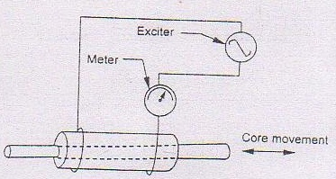
Transducers
Ratio (change in inductance/original inductance) = 50/1950 = 0.0256
Ratio ( displacement/ original gap) = 0.025/1.0 = 0.025
Since the two ratios are equal, we can say that the change in inductance is linearly proportional to the displacement. This proportionality is, however, true only for very small displacements.
Variable permeance transducer : Fig. 4.8 illustrates the variable permeance transducer where the inductance of the coil is changed by varying the amount of core material. The arrangement consists of a coil of many turns of wire wound on a tube of insulating material with a movable core of magnetic material.

Slide 22
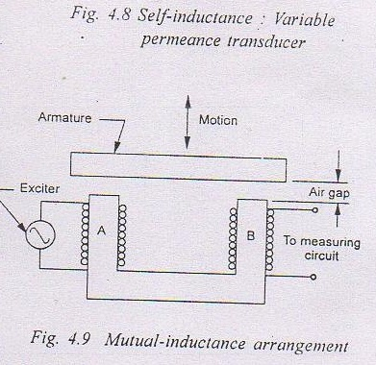
Transducers
As the coil is energised and the core enters the solenoid cell, the inductance of the coil increases in proportion to the amount of metal within the coil. A pickup of this type is used primarily for displacement, strain and force measurement.
Fig. 4.9 illustrates a form of two-coil mutual inductance transducer. Coil A is the energising coil and B is the pickup coil. A change in the position of the armature by a mechanical input alters the air gap. This causes a change in the output from coil B which may be used as a measure of the armature displacement, i.e., the mechanical input.

Slide 23
Transducers
Linear-variable differential transformer (LVDT) :
One of the most useful of the variable inductance transducers is the linear variable differential transformer shown schematically in Fig. 4.10. The device has one primary and two secondary windings with the magnetic core free to move inside the coils. The core is attached to the moving part on which the displacement measurements are to be made. When a.c. current is supplied to the primary winding, the magnetic flux generated by this coil is disturbed by the armature so that voltages are induced in the secondary coils. The secondary windings are symmetrically placed, are identical and are connected in phase opposition so that emfs induced in them are opposite to each other. The net output from the transformer is then the difference between the voltages of the two secondary windings.. The position of the magnetic core determines the flux linkages with each winding. When the core is placed centrally, equal but opposite emfs are induced in the secondary windings and zero output is recorded. This is termed as the balance point or null position.

Slide 24
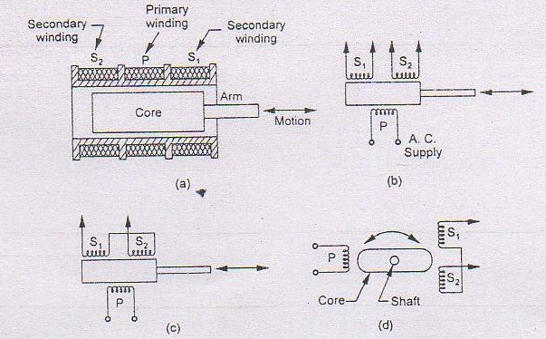
Transducers
A variation in the position of the core from its null position produces an unbalance in the reactance of secondary windings to the primary windings. The voltage induced in the secondary winding towards which the core is displaced increases. A simultaneous decreased induced voltage results from the secondary coil. Thus, upon displacement of the armature,

Slide 25
Transducers
the result will be a voltage rise in one secondary and a decrease in the other. The asymmetry in the core position thus produces a differential voltage E₀ which varies linearly with change in the core position (Fig. 4.11). Small residual voltages resulting form certain stray magnetic and capacitance effects may, however, not cancel and the output voltage may not necessarily become zero at the null position. Fig. 4.11 (b) represents an enlarged view of the residual voltage when the core is at the null position.
The differential transformers are available in a broad range of sizes and are widely used for displacement measurement in variety of applications. Some important characteristics and features of the LVDT type of displacement sensors are :

Slide 26
Transducers
simplicity of design, ease of fabrication and installation, rugged and durable construction * wide range of displacement; displacement ranges available from 2 x 10⁻⁴ m to 0.5 m * high output, low hysteresis, continuous (infinite) fin ite) resolution and linear electrical response
(linearity better than 0.5%) when actuated by linear mechanical motion
* negligible operating force and no wear of moving parts
The device, however, is not particularly sensitive and must be excited with a.c. only; excitation frequency 50 Hz to 20 kHz. Input voltage in limited by the current carrying capacity of the primary coil.

Slide 27
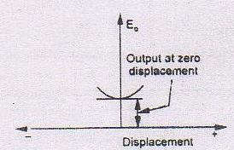
Transducers
Fig. 4.11 Output voltage of LVDT against position of core
Typical measurements are any quantities which can be transduced into displacement, e.g. pressure, acceleration, vibration, force and liquid level. The disadvantage lies in the area of dynamic measurement as its core is of appreciable mass in comparison to strain gauge.

Slide 28
Transducers
Advantages of LVDT:
1. High range: The LVDTs have a very high range for measurement of displacement (1.25 mm to 250 mm)
2. Since there is no physical contact between the movable core and coil structure, the LVDT is a frictionless device. This gives LVDT infinite mechanical life.
3.Immunity from external effects: The separation between LVDT Core and LVDT Coils permits the isolation of media such as pressurized, corrosive or caustic fluids from the coil assembly by a non magnetic barrier imposed between the core and inside of the coil. It makes the hermetic sealing of the coil assembly possible and eliminates the need for a dynamic seal on the moving member.
4. High input and high sensivity: The LVDT gives a high ouput and often amplification is not required.
5. Ruggedness: Can tolerate high degree of shock and vibrations especially when the core is spring loaded.
6. Low hysteresis: LVDTs show a low hysteresis and hence repeatability is excellent under all conditions.
7. Low power consumption: Most LVDT consume power less than 1 W

Slide 29
Transducers
Disadvantages of LVDT:
1. Relatively large displacements are required for appreciable differential output
2. Transducer performance is sometimes affected by vibration.
3. The receiving instrument must be selected to operate on a.c. signals or a demodulator must be used if d.c. ouput is required.
4. The dynamic response is limited mechanically by the mass of the core and electrically by the frequency of output.
5. Temperature affects the performance of the transducer.
Uses and applications: 1. The LVDT can be used in all applications where displacements ranging from fraction of a mm to a few cm have to be measured. The LVDT acting as a primary transducer converts the displacement directly into an electrical output proportional to displacement.
2. Acting as a secondary transducer, it can be used as a device to measure force, weight and pressure etc.

Slide 30
Transducers
Capacitive transducers:A capacitor comprises two or more metal plate conductors separated by an insulator. As voltage is applied across the plates, equal and opposite electric charges are generated on the plates. Capacitance is defined as the ratio of the charges to the applied voltage and for a parallel plate capacitor is given by
C = €₀ €r - A (N – 1)/t farads
where A = overlapping or effective area between plates (m²),
t = distance between plates (m),
N = number of capacitor plates,
€ ₀ = permittivity of free space = 8.854 x 10⁻'² F/m
€r = relative permittivity (or dielectric constant) of the material between the plates.
The value of €r depends upon the insulator material and for air €r = 1

Slide 31
Transducers
For a cylindrical capacitor, the capacitance is
r₂= radius of outer cylindrical conductor (m).
A capacitive pick up operates on the principle of a variation in capacitance produced by the physical quantity being measured. The capacitance can be made to vary by changing either the relative permittivity (dielectric constant) €,. , the effective area A, or the distance between the plates t. The mechanical displacement is generally measured by noting the change in capacitance brought about by either change in area or by change in distance between the plates. The change in dielectric is used to measure changes in liquid or gas levels.

Slide 32
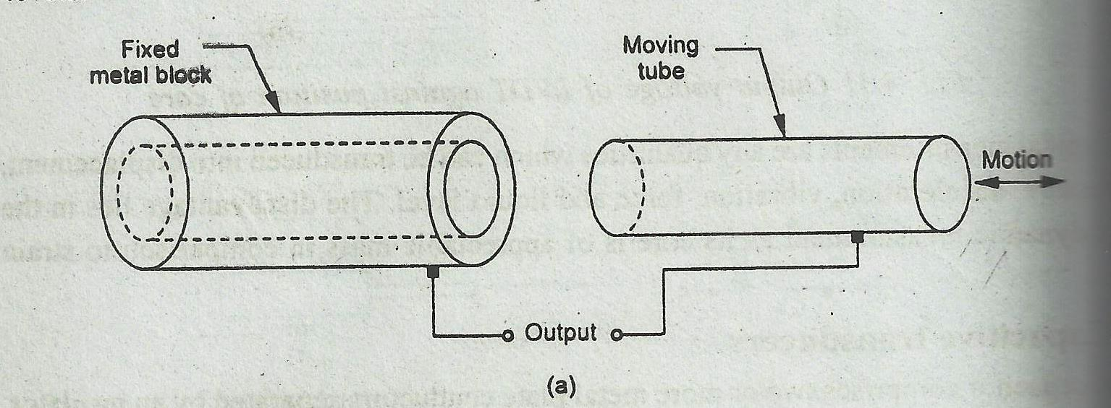
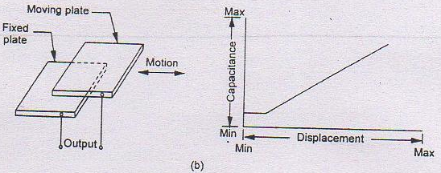
Transducers

Slide 33
Transducers
Fig. 4.12 Capacitance transducer: area change on previous slide.
Fig. 4.12 represents the elementary diagrams of the two arrangements of a capacitance transducer where capacitance change occurs because of change in the area of plates. Since capacitance is directly proportional to the effective area of the plates, response of such a system is linear.
Fig. 4.13 represents the basic form of a capacitance transducer utilizing the effect of change of capacitance with changes in distance between the two plates. One is a fixed plate and the displacement to be measured is applied to the other plate which is moving. Since capacitance varies inversely as the distance between the plates, the response of this transducer is not linear.

Slide 34
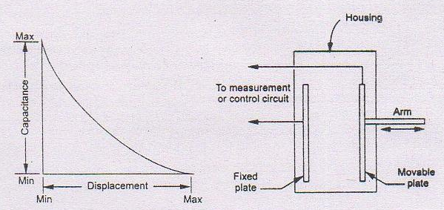
Transducers
Fig. 4.13 Capacitance transducer : change in distance between the plates
In a differential capacitor, let the normal position of the central plate be represented by a line as shown in Fig. 4.14. The capacitances C1 and C2 are then identical, i.e.,

Slide 35
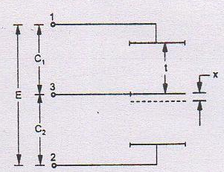
Transducers
4.11
4.11 Fig. 4.14 Differential capacitor
When the central plate is displaced parallel to itself through a distance x, the capacitances are :
4.12

Slide 36
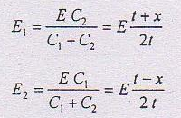
Transducers
For an alternating voltage E applied between the terminals 1 and 2, the voltages across C, and C, are given by :
When the output from the terminal pairs 1 and 3, and 2 and 3 is fed into a differential measurement circuit, the voltage difference would be recorded.
The voltage difference is a linear function of the displacement of the middle plate.

Slide 37
Transducers
Capacitance transducers can detect displacements as small as 2.5 x 10⁻⁶ m and produce a measurable signal. Parallel plate capacitance transducers have the advantages of easy fabrication, excellent high frequency response, good linearity output, ability to measure static and dynamic quantities and a relatively low initial and maintenance cost.
Example 4.4 The 3 cm region between the two plates of a parallel plate capacitor is filled by two dielectric layers :
a) 1 cm thick with dielectric constant 5, and
b)2 cm thick with dielectric constant 10.
What would be the relative permittivity (dielectric constant) of a material which gives the same capacitance if it completely fills the region between the plates ? •
Solution : For a multiple parallel plate capacitor with space between adjacent plates filled with different materials having dielectric constants Ɛ_{r1}, Ɛ_{r2}, Ɛ_{r3}, ------, and having
respective distances t₁ t₂, t_{3,-----} , we have :

Slide 38
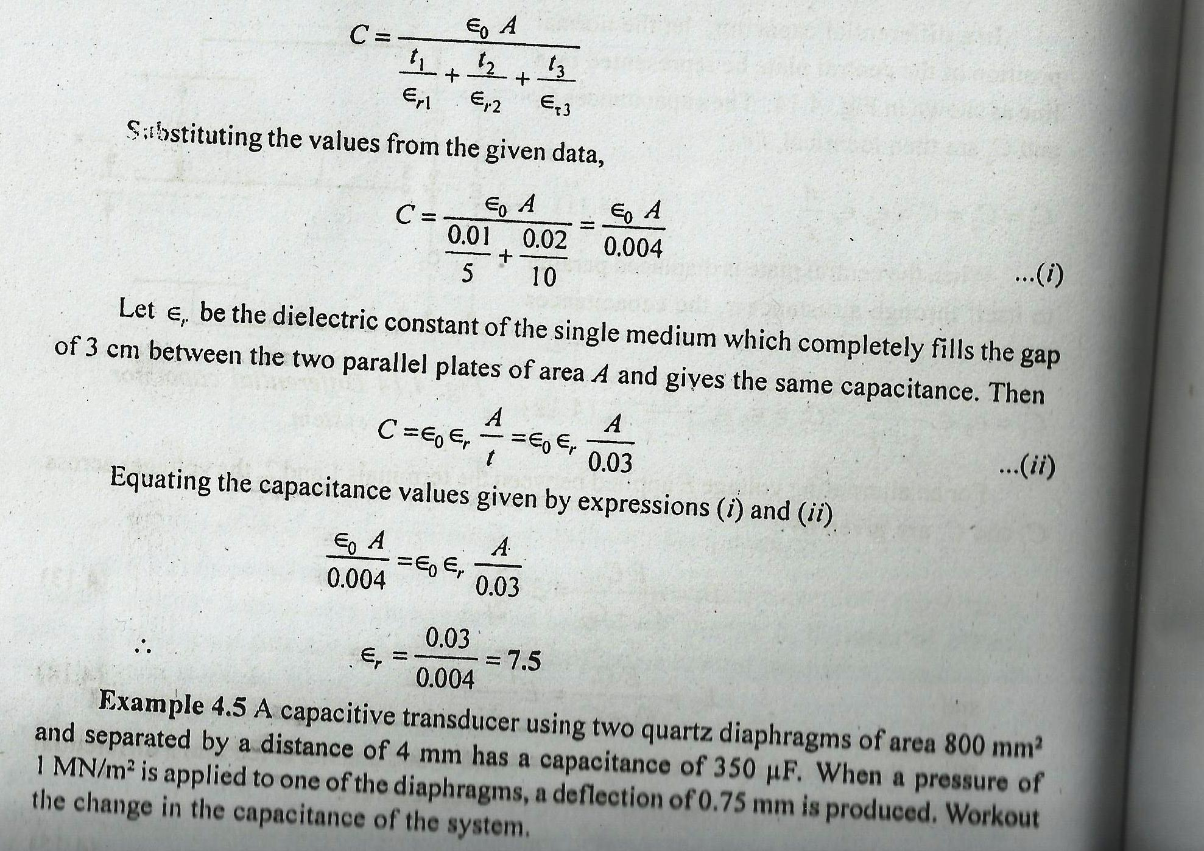
Transducers
Solution: Before application of pressure:
C₁ = Ɛ₀ Ɛ_{r} A/r₁

Slide 39
Transducers

Slide 40
Transducers

Slide 41
Transducers

Slide 42
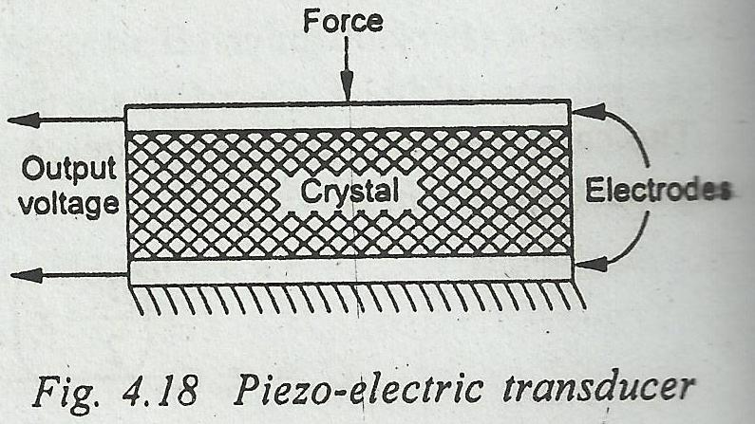
Transducers
4.12 Piezo electric transducers
Piezo-electricity represents the property of a number of crystalline materials that cause the crystal to develop an electric charge or potential difference when subjected to mechanical forces or stresses along specific planes. Conversely, the crystal would undergo change in

Slide 43
Transducers
thickness (and thus produce mechanical forces) when charged electrically by a potential difference applied to its proper axis. Elements exhibiting piezo-electric qualities are sometimes known as electro restrictive elements.
A typical mode of operation of a piezo electric device for measuring varying force applied to a simple plate is shown in Fig. 4.18. Metal electrodes are attached to the selected faces of a crystal in order to detect the electrical charge developed. lie magnitude and polarity of the induced charge on the crystal surface is proportional to the magnitude and direction of the applied force and is given by :
Q = K F ...(4. 1 6)
there Q is the charge in coulomb, F is the impressed force in newtons and K is the crystal sensitivity in C/N; it is constant for particular crystals and the manner in which they are cut. The relationship between the force F and the change Sr in the crystal thickness t is given by the stress-strain relationship.

Slide 44
Transducers

Slide 45
Transducers
where g is the crystal voltage sensitivity in Vm/N and P is the applied pressure in N/m².
There are two main groups of piezo-electric crystals: (i) natural crystals such as quartz and tourmaline, (ii) synthetic crystals such as Rochelle salts, lithium sulphate (LS), ammonia dihydrogen phosphate (ADP), ethylene diamine tartrate (EDT), dipotassium tartrate (DKT) etc. The advantages vary from crytal to crystal and one is chosen on the basis of a particular application. Tourmaline is the least active chemically while tartaric acid is most active electrically.
* Natural crystals have a very low electrical leakage when used with very high input impedance amplifiers and permit the measurement of a slowly varying parameter. They are, therefore, capable of withstanding higher temperatures, operating at low frequencies and sustaining shocks.

Slide 46
Transducers
* Synthetic crystals exhibit a much high output for an applied stress and are about thousand times more sensitive than natural crystals. However, they are usually unable to withstand high mechanical strain without fracture. Further, the synthetic crystals have an accelerated rate of deterioration over the natural ones.
The major advantages of piezoelectric transducers are:
* high frequency response,
* high output,
* rugged construction
* negligible phase shift, and
* small size. The small size of the transducer is especially useful for accelerometers where added mass will mechanically load a system.

Slide 47
Transducers
The unit, however, has the disadvantage in that it cannot measure static conditions and that its output is affected by changes in temperature. When an instrument is electrically connected to measure the electrical charge generated, it is slowly dissipated through the internal resistance of the crystal, i.e.. the charge decreases over a period of time. Because of thiS characteristic, the piezoelectric transducers have a poor steady state response and as such are used mainly for measuring dynamic quantities (parameters varying rapidly with time). Special amplifiers with very high input impedance (10¹² to 10'³ ohms) can however, be used to measure the static or quasi-static quantities, but that makes the measuring system increasingly expensive.
Applications : Piezo-electric transducers are most often used for accelerometers, pressure cells and force cells in that order.

Slide 48
Transducers
Example 4.12 A quartz crystal having a thickness of 2 mm and a voltage sensitivity of 0.05 Volt-m/newton is subjected to a pressure of 15 x 10⁵ N/m². Calculate the voltage developed by the piezo-electric pick up.
Solution: The output voltage for a piezo-electric pick up is given by V_{o} = g t P = 0.05 x 0.002 x (15 x 10⁵) = 150 V
Example 4.13 A quartz pressure tranducer has sensitivity of 80 x I0⁻¹² coulomb/bar. An output voltage 1.2 V is produced when the crystal is subjected to a pressure of 3.5 bar. Workout the capacitance of the device.
Solution : Charge Q = sensitivity K x pressure force F
= 80 x 10⁻'² x 3.5 = 280 x 10⁻¹² coulomb
Output voltage V_{o} = charge Q / Capacitance C
Capacitance C = 280 X 10⁻¹²/ 1.2 = 2.3 X 10⁻¹⁰ farads

Slide 49
Transducers

Slide 50
Transducers
Photo-electric transducers
These tranducers operate on the principle that when light strikes special combination of materials, a voltage may be generated, a resistance change may take place, or electrons may flow. Photoelectric cells are used for a wide variety of purposes in control engineering, for precision measuring devices, in exposure meters used in photography. They are also used in solar batteries as sources of electrical power for rockets and satellites used in space research. Photo­electric transducers offer the advantage that they do not involve any contact being made with the system being measured; just interruption of a beam of light. Further, the light does not have to be visible ; they can be selected to operate with infrared radiation. Photo electric transducers can be grouped into: photo-emissive (photo tube), photo-conductive, and photo-voltaic cells.

Slide 51
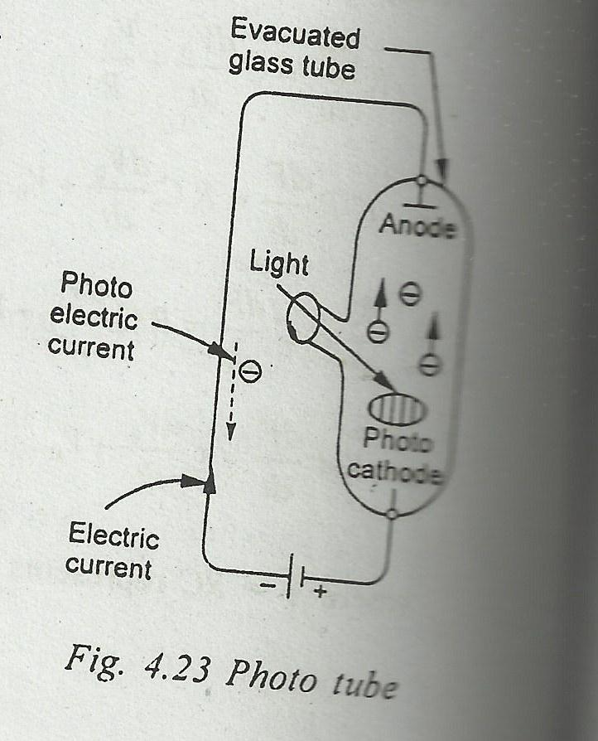
Transducers
Photo-emissive cell : These transducers (Fig. 4.23) operate on the photo-emissive effect, i.e., when certain types of materials are exposed to light, electrons are emitted and a current flow is produced.

Slide 52
Transducers
The light sensitive photo-cathode may consist of a very thin film of cesium deposited by vaporisaticn onto an oxidised silver base. Light strikes the cathode, causing the emission of electrons which are attracted towards the anode This phenomenon produces flow of electric current in the external circuit; the current being a function of radiant energy striking the cathode.
There exit three separate types of photo-emissive cells ; the high vacuum single cathode, the gas filled and the multiplier tubes. The high vacuum and the gas filled tubes are both diodes where the cathode and anode are enclosed in a glass or quartz envelope which is either.evacuated or filled with an inert gas. The difference lies in the extent of the vacuum and the kind of inert gas The photo-multiplier tubes use the principle of secondary emission. Tire device consists of a series of reflecting electrodes, called dynodes, which amplify. the original output current. The dynodes are so arranged that the electrons striking a dynode produce further electron emission from the dynode.

Slide 53
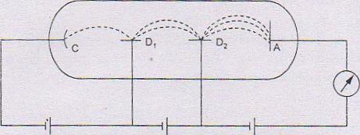
Transducers
The number of emitted electrons can be increased and high gains made possible by using a photo multipliers.
Fig. 4.24 Photo-multiplier tube
With reference to Fig. 4.24, voltage .E1, accelerates the electrons emitted by cathode C and these are focussed onto the dynode D₁. Each incident electron causes emission of secondary electrons which subsequently get focussed upon dynode D2,. Finally these are attracted by the anode A leading to generation of current I.

Slide 54
Transducers
Photo-conductive cell : These are the variable resistance transducers. They operate on the principle of photo conductive effect, i. e., some special type of semiconductor materials change their resistance when exposed to light.
Fig. 4.25 shows schematically the construction and electrical circuit of a photo­conductive cell. The sensitive material usually employed is cadmium sulphide, cadmium selenide, germanium etc in the form of thin coating between the two electrodes on a glass plate. Further, the cells are used in the circuit as a variable resistance and are put in series with an ammeter and a voltage source. When the light strikes the semiconductor material, there is a decrease in the cell resistance thereby producing an increase in the current indicated by the ammeter.

Slide 55
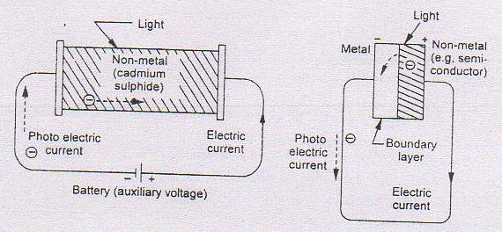
Transducers
Fig 4.25 Photoconductive cell Fig. 4.26 Photo-voltaic cell

Slide 56
Transducers
4.13.3 Photo-voltaic cell : These transducers operate on the photo-voltaic effect, i.e., when light strikes a junction of certain dissimilar metals, a potential difference is built up.
The cell consists of a metal base plate, a non-metal semiconductor and a thin transparent metallic layer (Fig. 4.26). Typical examples of the layers are the copper oxide on copper and iron oxide on iron combination. The transparent layer may be in the form of a sprayed conducting lacquer. Light strikes the coating and generates an electric potential. The output is, however, low and is non-linear function of the light intensity. In contrast to photo-tube and photo-conductive cells, the photo-voltaic unit is self-generated and requires no voltage source to operate it. Further, it need not be operated in vacuum or gas filled envelope. The most common application of photo-voltaic cell is in light exposure meter in photographic work.

Slide 57
Transducers
MAGNETOSTRICTIVE TRANSDUCERS
Magnetostrictive transducers are similar to piezoelectric transducers and are based on the application of the magnetostriction phenomenon. They are converters of mechanical energy into magnetic energy and are also known as magnetoelastic transducers. The phenomenon is reversible and the devices developed convert energy from one form to another. The natural frequency of the transducers can be as high as 10 kHz and are very much used as transmitters (senders) and receivers in vibration and acoustic studies. The transducers possess very high mechanical input impedance and are suitable for measurement of force and hence acceleration and pressure. They can measure large forces, both static and dynamic. They are rugged in constructional features and, when used as active transducers, the output impedance is low. Nickel and nickel-alloys are mostly used. It is the basic nonlinearity in the B-I4 characteristic which is responsible for its limited scope of application, especially when high accuracy is desired. Each transducer needs calibration before use.

Slide 58
Transducers
Magnetostriction Phenomenon
Certain ferromagnetic materials are considerably affected in their magnetic properties when they are mechanically stressed. This phenomenon is known as magnetostriction (Villari effect) and is particularly significant in nickel and nickel-iron alloys. The noise in transformer is due to the reverse effect. The shape and size of the B-H characteristic and the B-H loop is sufficiently altered when the material is subjected to tensile. compressional or shear stress. The B-H characteristics of nickel and nickel-iron (Ni, 68%) alloy are presented in Figure 7.20. showing the effect of increasing tensile stress a on the materials. Similarly, the magnetization

Slide 59
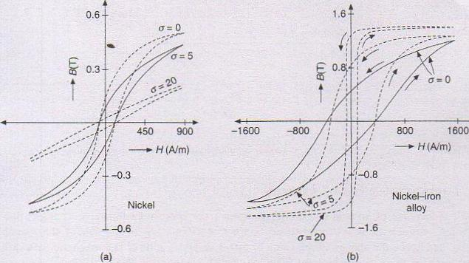
Transducers
B-H characteristics under different stress values: (a) For nickel; (b) for nickel-iron alloy.

Slide 60
Transducers
characteristic is affected and it is observed that the permeability increases with increase in tensile stress in the case of nickel-iron alloys and decreases in the case of pure nickel. The change in the shape of the B-H loop alters the remnance B, of the material. When B, and permeability decrease with increase in stress, it is known as negative magnetostriction; otherwise, it is called positive magnetostriction. Also, the percentage of nickel in the nickel-iron alloy has considerable influence on the characteristics. The materials are sensitive to the polarity of stress and hence the transducers enable measurement of alternating forces. Some ferrite materials such as `Ferroxcube B' exhibit magnetostriction of considerable degree but due to their brittleness, they are not used. Even the magnetostrictive transducers employing nickel or nickel-iron alloys would have competed with the piezoelectric transducers, if the effects of stress on permeability and remnance are linear without showing any hysteresis. The transducers need mechanical bias, so as to make them suitable for application of cyclic stress. Figure 7.21(a) shows the variation of B with stress at different values of H, and Figure 7.21(b) shows the effect of superposition of cyclic torsion on tensile stress for the case of a nickel sample.

Slide 61
Transducers
Photo-electric transducers
These tranducers operate on the principle that when light strikes special combination of materials, a voltage may be generated, a resistance change may take place, or electrons may flow. Photoelectric cells are used for a wide variety of purposes in control engineering, for precision measuring devices, in exposure meters used in photography. They are also used in solar batteries as sources of electrical power
for rockets and satellites used in space research. Photo­electric transducers offer the advantage that they do not involve any contact being made with the system being measured; just interruption of a beam of light. Further, the light does not have to be visible ; they can be selected to operate with infrared radiation. Photo electric transducers can be grouped into: photo-emissive (photo tube), photo-conductive, and photo-voltaic cells.

Slide 62
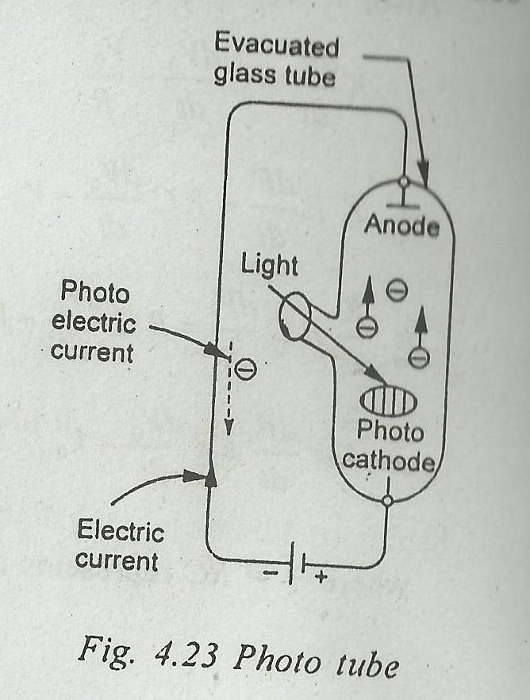
Transducers
Photo-emissive cell: These transducers (Fig. 4.23) operate on the photo-emissive effect, i.e., when certain types of materials are exposed to light, electrons are emitted and a current flow is produced. light information current information.

Slide 63
Transducers
The light sensitive photo-cathode may consist of a very thin film of cesium deposited by vaporisaticn onto an oxidised silver base. Light strikes the cathode, causing the emission of electrons which are attracted towards the anode This phenomenon produces flow of electric current in the external circuit; the current being a function of radiant energy striking the cathode.
There exit three separate types of photo-emissive cells ; the high vacuum single cathode, the gas filled and the multiplier tubes. The high vacuum and the gas filled tubes are both diodes where the cathode and anode are enclosed in a glass or quartz envelope which is either.evacuated or filled with an inert gas. The difference lies in the extent of the vacuum and the kind of inert gas The photo-multiplier tubes use the principle of secondary emission. Tire device consists of a series of reflecting electrodes, called dynodes, which amplify. the original output current. The dynodes are so arranged that the electrons striking a dynode produce further electron emission from the dynode.

Slide 64
Transducers
The number of emitted electrons can be increased and high gains made possible by using a photo multipliers.
With reference to Fig. 4.24, voltage .E, accelerates the electrons emitted by cathode C and these are focussed onto the dynode D_{i}. Each incident electron causes emission of secondary electrons which subsequently get focussed upon dynode D,. Finally these are attracted by the anode A leading to generation of current I.
4.13.2 Photo-conductive cell : These are the variable resistance transducers. They operate on the principle of photo conductive effect, i. e., some special type of semiconductor materials change their resistance when exposed to light.

Slide 65
Transducers
Fig. 4.25 shows schematically the construction and electrical circuit of a photo­conductive cell. The sensitive material usually employed is cadmium sulphide, cadmium selenide, germanium etc in the form of thin coating between the two electrodes on a glass plate. Further, the cells are used in the circuit as a variable resistance and are put in series with an ammeter and a voltage source. When the light strikes the semiconductor material, there is a decrease in the cell resistance thereby producing an increase in the current indicated by the ammeter.

Slide 66
Transducers
Fig. 4.25 Photo-conluctive cell Fig. 4.26 Photo-voltaic cell

Slide 67
Transducers
Photo-voltaic cell : These transducers operate on the photo-valtaic effect, i.e., when light strikes a junction of certain dissimilar metals, a potential difference is built up.
The cell consists of a metal base plate, a non-metal semiconductor and a thin transparent metallic layer (Fig. 4.26). Typical examples of the layers are the copper oxide on copper and iron oxide on iron combination. The transparent layer may be in the form of a sprayed conducting lacquer. Light strikes the coating and generates an electric potential. The output is, however, low and is non-linear function of the light intensity. In contrast to photo-tube and photo-conductive cells, the photo-voltaic unit is self-generated and requires no voltage source to operate it. Further, it need not be operated in vacuum or gas filled envelope. The most common application of photo-voltaic cell is in light exposure meter in photographic work.

Slide 68
Transducers
HALL-EFFECT TRANSDUCERS
The Hall effect was discovered in 1879 and belongs to one of the galvanomagnetic phenomena in which the interaction between the magnetic field and moving electrical charges results in the development of forces that alter the motion of the charge. The Hall effect is observed in all metals, but it is very much prominent in semiconductor materials. A thin strip of bismuth or n-type germanium is subjected to magnetic field B normal to its surface as shown in Figure 7.25, while it carries a current I along the length of the strip, but normal to B. The magnetic field exerts a force (known as Lorentz force) on the electrons moving at a velocity v, with the result that some of them drift towards the edges of the strip. The edge surfaces act like charged electrodes and the potential difference measured between P and Q is known as Hall

Slide 69
Transducers
Hall Effect Transducers
potential E_{H} which increases with increase of B-and I. The build-up of the charge on the edge surfaces will, in turn, develop an electric field (Hall field) of such a polarity that counteracts the collection of charges on the surfaces. The force on the electrons due to Hall field and the Lorentz force balance each other finally. The time required to reach this equilibrium is about 10 ⁻¹⁴ s.

Slide 70
Transducers
If e is the charge of the electron, then the Lorentz force Bev and the force due to Hall field are equal to each other. Hence
Bev = eE_{H} lb (7.16)
EH = Bbv (volts)
Where, B = the magnetic flux density, v = velocity, m/s , b = width, m
The electrons ant the free charge carriers assume a velocity along the length of the strip, which is proportional to electric field along the direction of motion. If the mobility of the charge carriers is represented by χ then v is given by
v = χE_{b} /L

Slide 71
Transducers
and using E_{b} = IρL/bt, v is given by χ Iρ/bt. Hence,
E_{H} = ρχBI / t = K_{H}BI / t
Where, K_{H} = Hall Constant (=χρ)
t= thickness of the strip, m
L= Length of the strip, m
The Hall coefficient depends on the number of free charge carriers per unit volume. The coefficient for metals and semiconductors is given by
K_{H} = K (nχ²_{n} - pχ²_{p})/ e (nχ_{n}+ p χ_{p})
where,
K = a positive constant (K = 1 for metals and 3𝜋/8 for semiconductors)
n,p = No. of free electrons and holes per m³
Χ_{n} and χ_{p} = mobility of the electrons and holes respectively
e = charge of the electron

Slide 72
Transducers
Table 7.3 provides the values of the Hall coefficients for n-type conductors.
As the number of free charge carriers in semiconductors is far less than in metals, semiconductors possess a very large value for Hall coefficients. However, semiconductors are highly sensitive to temperature. The current passage through the element creates noise and the current should be limited to very low values. The advantages are that semiconductors are extremely fast and require very little space.

Slide 73
Transducers
Table 7.3 Hall Coefficients of n type materials
Material | K_{H} Vm/AT
Copper | -5.3 X 10 ⁻¹¹
Silver | -9 X 10 ⁻¹¹
Bismuth | -5 X 10 ⁻¹¹
Silicon | 10 ⁻²
Germanium | -3.5 X 10 ⁻²

Slide 74
Transducers
Applications of Hall Transducers
The Hall effect transducer is primarily suited for the measurement of magnetic fields. It is preferred for mapping of magnetic field around conductors carrying large currents under different flow conditions, with and without the presence of metallic objects in their vicinity. This transducer has made it possible to measure dc and ac currents in conductors without interruption of the circuit and without making any electrical contact with the conductor. The range of current that can be measured in this manner can be as low as 0-1 mA or as high as 0-1 kA. Wattmeters of different ranges are available for measurement of dc and ac power at frequencies up to 10 kHz. B is proportional to load current and I to load voltage.
In the field of instrumentation, the Hall element is highly valued for its speed of response in detection of changes in the magnetic field to which it is exposed. The advantages are its small size and high sensitivity. It is used as a proximity detector as it does not require to establish a mechanical link with the test object. It is used to measure the change in the strength or direction of the magnetic field due to the displacement or nearness of the test object. In other words, it can be used as a displacement transducer, provided the test object can distort the magnetic field due to its motion.

Slide 75
Transducers
Otherwise, the test object has to be mechanically coupled to the Hall effect element, already lying in a steady magnetic field of constant strength. Its application as angular displacement transducer and proximity detector can be understood from Figure 7.26. As the element can respond to quick changes in the field, it is equally applicable for measurement of amplitudes of vibration of objects and count the number of fast moving objects across the magnetic field.
In all the above applications, the current through the element should be held constant at about 5-20 mA dc by using constant current sources. The value of E_{ll} for the case of an n-type germanium element, carrying a current of 10 mA is 1.4 mV when exposed to a magnetic field of 0.1 mT. The output impedance varies from one element to another and is about 5-200 ohms, depending on the material and size of the element.

Slide 76
Transducers
IONIZATION TRANSDUCERS
Ionization transducers are based on the process of ionization of a gaseous medium contained in a chamber at low pressure. The atoms of the gas are split into ions and electrons which are drawn towards the respective electrodes to constitute current. The ionization of the gas may be effected either by fast moving electrons, exposure to high-energy radiation of X-rays and gamma rays or by bombardment of the gas by particulate matter such as a- and β-particles and neutrons. The ultraviolet region of the electromagnetic spectrum extends from 380 nm down to small wavelengths overlapping the soft X-ray region.

Slide 77
Transducers
Gamma rays have wavelengths from 0.1 nm and below, and hence they are considered to be high-energy electromagnetic waves. α-particles, ft-particles, neutrons and 'rays are emitted by radioactive materials (called isotopes), and they are known as nuclear radiation. An a-particle is a helium nucleus having a positive charge of 2 and a relative mass of 4. A β particle is an electron having a relative mass of 0.000549. The neutron has zero charge and a relative mass of unity. Alpha particles are rather readily absorbed in many materials, while β particles are usually more penetrating. Neutrons and gamma rays are the most penetrating types of radiation.

Slide 78
Transducers
Nuclear radiation detectors are normally known as ionization chambers, Geiger counters or scintilation counters and are based on the interaction of the radiation with the detecting system that produces an ionization process. A variety of nucleonic instruments are developed in spite of the hazards posed by the radioactive materials. In most of the instruments, the sources are shielded heavily, thereby making them very safe for the operating personnel. The nucleonic instruments are developed for application to situations where other methods fail as also for effecting noncontact and noninvasive measurements.

Slide 79
Transducers
The vacuum gauge with heated cathode resembles a thermionic valve as shown in Figure 7.41(a). The chamber is connected to the vacuum source, the pressure of which is below 1 µm when the mean free path of the electrons becomes fairly long. The anode is held at a negative potential of about 25 V, whereas the grid is at a positive potential of 100 V. Some of the electrons emitted by the cathode strike the gas molecules during their transit towards the grid. The secondary electrons thus released are, in fact, a small fraction of the electrons emitted from the cathode, as the pressure of the gas is very low. The number of positive ions formed is directly proportional to the gas pressure and also proportional to the number of primary electrons emitted. The positive ions are collected by the negatively charged anode and the electrons by the grid. The number of primary electrons and hence the grid current I_{g} is generally held constant and so the anode current I_{a} is a measure of the number of gas molecules per unit volume and hence of the pressure. The sensitivity S of the gauge is given by

Slide 80
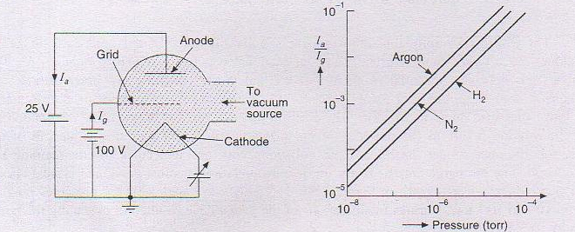
Transducers
S= I_{a}/Pi_{g} where P is the pressure of the gas.
Figure 7.41 (a) Ionization vacuum gauge; (b) its characteristics.

Slide 81
Transducers
The sensitivity varies with the construction of the gauge and is different for different gases as shown in Figure 7.41(6). The gauge is used for the measurement of pressure over a very wide range from 1 torr to 10⁻¹⁰ torr The merits of the gauge are linearity in the range of pressure and high speed of response. It is the most accurate of all vacuum gauges and the calibration constant and sensitivity remain constant for some time. The drawback of the gauge is that the filament burns out if accidentally the pressure of gas becomes higher than 1 torr. The life of the cathode and gauge is affected by the temperature at which the cathode operates and hence the gauge needs calibration at regular intervals.

Slide 82
Transducers
Ionization Displacement Transducer
Ionization displacement transducers are based on the ionization of a gas when exposed to intense electric field of a high frequency of about 0.5-1 MHz. The gas is enclosed inside a small tube at a pressure of about 10 torr and the tube is provided with two electrodes, as shown in Figure 7.45(a). Under the intense electric field, a glow discharge occurs in the space and the electrodes serve to indicate the potential difference due to the discharge. The tube is known as glow discharge tube. Their potential is determined by the space potential of the plasma surrounding each electrode and by the radio frequency potential induced due to their capacitative coupling with the external plates. The potential difference E₀ is zero when the tube is lying at the centre and symmetrically with respect to the plates, and is proportional to x when displaced from the central position. The dc voltage thus developed changes polarity when moving from one side to the other side of the central position. The characteristic between displacement and E is linear over a large part of the range about the centre as shown in Figure 7.45(b), and the sensitivity can be as high as 1 kV per mm of displacement, depending on the design of the system.

Slide 83
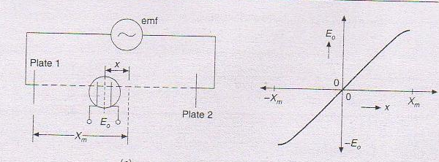
Transducers
(a) Ionization displacement transducer (b) its characteristics
If the range of displacement is about 1 cm, the above system requires very large voltage across the plates. So a modified version, consisting of a long tube provided with a movable metal ring placed over it, is developed. The radio frequency generator is connected to the electrodes of the tube, as shown in Figure 7.46(a). A discharge takes place between the ring and each electrode. The direct voltage L_{o} across the electrodes of the tube is a measure of the position of the ring, and is proportional to x over a major length of the tube (see Figure 7.46b). The sensitivity is of the order of 1 to 10 V per mm.

Slide 84
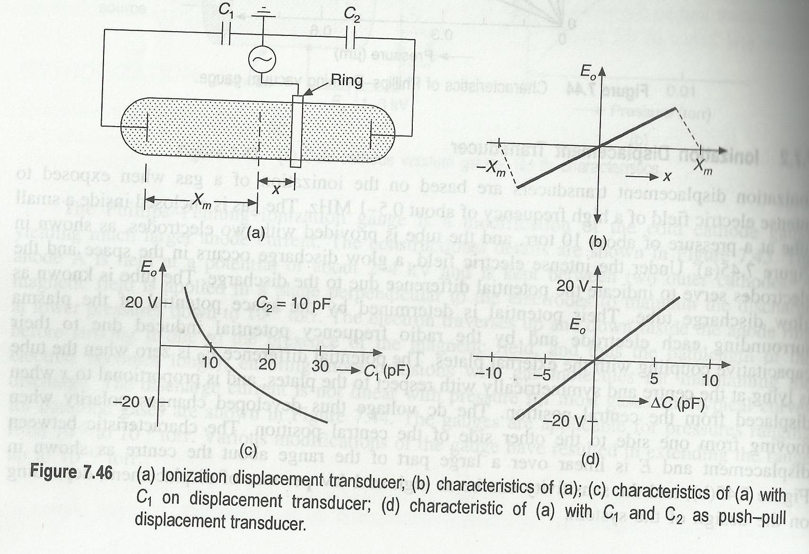
Transducers
Both the above displacement transducers are suitable for measurements of steady displacements as well as dynamic displacements of frequencies up to 50 kHz, with an accuracy of ±0.1% and linearity of ±0.1% over a range up to 15 cm.

Slide 85
Transducers
THERMOELECTRIC TRANSDUCERS
A thermocouple is a thermoelectric device that converts thermal energy into electrical energy. The thermocouple is used as a primary transducer for measurement of temperature, converting temperature changes directly into emf. Three phenomena which gown the behaviour of a thermocouple are the Seebeck effect, the Peltier effect, and the Thompson effect.
Thermoelectric Phenomena
If two wires of different metals A and B are joined together to form two junctions and if the two junctions are at different temperatures, an electric current will flow round the circuit. This is the Seebeck effect. Seebeck arranged 35 metals in order of their thermoelectric properties. The current flows across the hot junction from the former to the latter metal of the following series:
B i—Ni—Co—Pd--Pt---
U—Cu—Mn—Ti—Hg—Pb–
Sn--Cr—Mo--Ph—Ir—Au—Ag­
Zn—W—Cd—Fe—As—Sb—Te.

Slide 86
Transducers
If metal A is of copper and metal B of iron, then the current flows from copper to iron at the hot junction and from iron to copper at the cold (reference) junction as shown in Figure 7.1(a). If copper wire is cut, an emf will appear across the open circuit. The Seebeck emf depends on the difference in the temperatures of the two junctions.
The reverse phenomenon is the Peltier effect. An external source of emf is connected, as shown in Figure 7.1(b), and a current is forced through the junctions. It is observed that heat is absorbed when the current flows across the iron-copper junction from copper to iron and liberated if the flow of current is reversed. The amount of heat liberated or absorbed is proportional to the quantity of electricity that crosses the junction, and the amount of heat liberated or absorbed when one ampere passes for a second is called the Peltier coefficient.

Slide 87
Transducers
Another reversible heat-flow effect, called the Thompson effect; involves the contribution of emf to Seebeck emf in the wire of the same metal, if a temperature difference existed within that particular conductor. When a current flows through a copper conductor having a thermal gradient (and hence a heat flow) along its length, heat is liberated at any point where the current is in the same direction as the heat flow while heat is absorbed at any point where these are opposite. In iron, on the other hand, heat is absorbed at any pointwhen the current flows in the direction of heat flow while heat is liberated when the current flows in the direction opposite to the flow of heat.
It will be seen, therefore, that the Seebeck effect is a combination of both the Peltier and Thompson effects and will vary according to the difference of temperature between the two junctions and with the metals chosen for the couple. It is essential that no current is allowed to flow in the thermoelectric circuit, if the Seebeck emf is under measurement. Seebeck emf measured by a high resistance voltmeter (or dc potentiometer) is different from the one

Slide 88
Transducers
measured by a conventional low impedance millivoltmeter. Potentiometric voltage measurements yield high accuracy in measurement of Seebeck emf. The total Seebeck emf produced is thus partly due to Peltier effect and partly due to Thompson effect. The Peltier emfs are assumed proportional to the temperature of the junction while Thompson emfs are proportional to the difference between the squares of the junction temperatures. Thompson enf is very low as compared to Peltier emf. Temperature measurements based on the thermoelectric phenomena rely entirely on empirical calibration and application of the thermoelectric laws established from a lot of experience. The emf produced by any thermocouple with the junctions at any two temperatures may be obtained from a thermoelectric diagram. Lead does not show any measurable Thompson effect. Hence the emf acting on a couple formed of a metal and lead for a change of temperature of one junction is represented on this diagram. The characteristic showing the emf per degree against the temperature of the hot junction is known as the thermoelectric line; Figure 7.2 shows such lines for some common metals. The ordinate is taken as positive when for a small increase of temperature, the current flows from lead to the metal at the hot junction. These lines enable computation of emf acting around a thermoelectric circuit formed of any two metals having their junctions at any two temperatures.

Slide 89
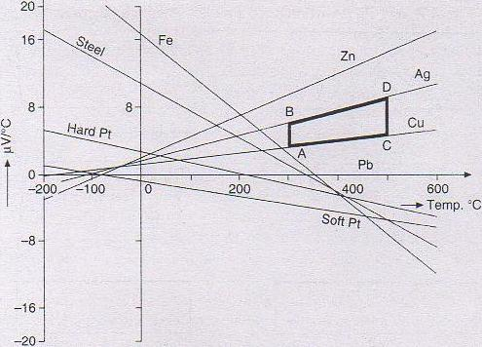
Transducers
Figure 7,2 Thermoelectric lines for different metals.

Slide 90
Transducers
Thermoelectric lines for certain metals are of negative slope. If a silver-copper thermocouple has its junctions maintained at 300°C and 500°C respectively, then the emf acting around the circuit is represented by the area of the trapezium ABCD, i.e., [(AB + CD)/2] x (200). But if copper and iron are used with the cold junction at 0°C, the emf goes on increasing with temperature of the hot junction up to 275°C where the two thermoelectric lines intersect. With further increase in temperature, the emf starts falling and becomes zero at 550°C. Later. the polarity of emf is reversed and its value goes on increasing with increase in temperature. The temperature at which the thermoelectric lines intersect is known as neutral temperature. While choosing materials to form a thermocouple, it is important to observe that the neutral temperature does not fall within the range of temperature to be measured.

Slide 91
Transducers
To measure the thermo-emf in a thermoelectric circuit, introduction of a millivoltmeter or some voltage measuring system is necessary, which amounts to addition of conductors and formation of junctions. The following laws are established to help understand the effects of additional junctions.
Law of intermediate metals. A third homogeneous metal C is introduced into one of the conductors as shown in Figure 7.3(a). The net emf of the circuit remains the same as long as the new junctions formed are at the same temperature. Also, it is at times necessary to insert the third metal C between wires of A and B by opening the junction at T₁ as shown in Figure 7.3(a). In such a case, the net emf again remains the same as long a4 the newly formed junctions are at T₁ only.
Law of intermediate temperatures. The third conductor of metal C introduced into the circuits of Figure 7.3(a) may assume any temperature without affecting the net mf as long as its two junctions with other metals are at the same temperature. If a certain thermocouple produces an emf E₁ when its junctions are at T_{i} and T2, and it produces E2 when at 7; and T3, it will produce E_{r} + E₂ when the junctions assume temperatures of T₁ and 1¹₃ as shown in Figure 7.3(b).

Slide 92
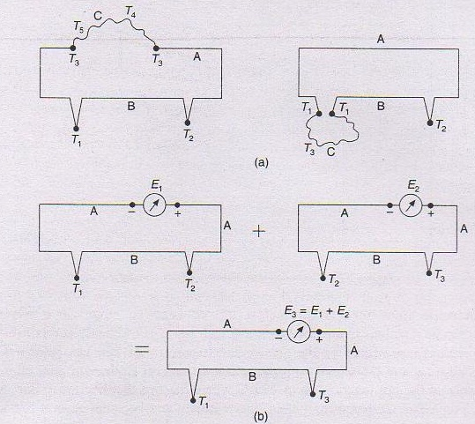
Transducers
Figure 7.3 Illustration of thermoelectric laws: (a) Law of intermediate metals; (b) law of intermediate temperatures.

Slide 93
Transducers
Applying the above laws, it can be seen that: Long lead wires connecting the junctions may be exposed to an unknown temperature environment, without affecting the net thermo emf.
A voltage measuring system may be connected as shown in Figure 7.3, while observing that the new junctions formed are at the same temperature.
Thermocouple junctions may be formed by soldering. welding or brazing.
If the cold junction is kept at a temperature other than 0°C, it is possible to apply correction by referring to standard tables of emfs, provided the temperature of the cold junction is accurately known.

Slide 94
Transducers
computer are under development. Direct digital transducers provide output signals in the form of rectangular pulses of constant duration and amplitude, the presence or absence of which in its time slot is taken to stand for either 1's or 0's. However, transducers are treated as digital type. if they provide pulses whose pulse rate is counted. Similarly, transducers whose output signals are sinusoidal and the frequency of which is related to measurand are considered to be digital type when working in combination with digital frequency measuring system. Such transducer systems may be treated as indirect digital type. A few direct and indirect digital transducers are briefly described in the following sections.

Slide 95
Transducers
computer are under development. Direct digital transducers provide output signals in the form of rectangular pulses of constant duration and amplitude, the presence or absence of which in its time slot is taken to stand for either 1's or 0's. However, transducers are treated as digital type. if they provide pulses whose pulse rate is counted. Similarly, transducers whose output signals are sinusoidal and the frequency of which is related to measurand are considered to be digital type when working in combination with digital frequency measuring system. Such transducer systems may be treated as indirect digital type. A few direct and indirect digital transducers are briefly described in the following sections.

Slide 96
Transducers
Digital Displacement Transducers
One of the direct digital transducers is the digital encoder for linear and angular displacements. It is also known as linear or angular digital encoder (LDE or ADE). Such transducers are availatle in different sizes 10th differing resolution and accuracy. Basically, they are divided into two types: incremental and absolute encoders. Incremental encoders require a counting system which adds increments of pulses generated by an encoder, a sensing system, and some datum from which increments are added or subtracted. Absolute encoders present a digital readout for each angular position and do not require a datum.
All encoders require a sensing system of either the contacting type using brushes or the noncontacting optical technique.

Slide 97
Transducers
The encoders shown in Figures 7.55 and 7.56 consist of two distinct regions signifying the two logic level signals, 0 and 1. The linear encoder of Figure 7.55 for the contacting type has a pattern of metallic areas on a matrix of nonconducting areas. All the metallic areas get connected together and energized through a fixed brush that rests on a continuous track and is in contact for all positions. The encoder shown has four tracks, resulting in digital output in four bits. The length of the encoder is 16 times the length of traverse required for a change of the digit in the least significant bit. If a resolution of 0.2 mm is desired in the measurement, a maximum traverse of the encoder in the direction shown is 3 mm. The brush makes contact over an area of each track much less than 0.2 x 0.2 mm. As the scale of encoder moves under the four tracks, the respective lamp circuits are connected or broken so that the position of scale is read out by noting the lamps under glow. Thus, 0000 stands for no flow of any lamp, and 1111 for glow of all lamps. If travel longer than 3 mm is desired, the number of tracks must be increased. If a higher resolution is needed, the number of tracks must be increased, in which case, much finer brushes are required. The limitation is generally due to the sensing or scanning system.

Slide 98
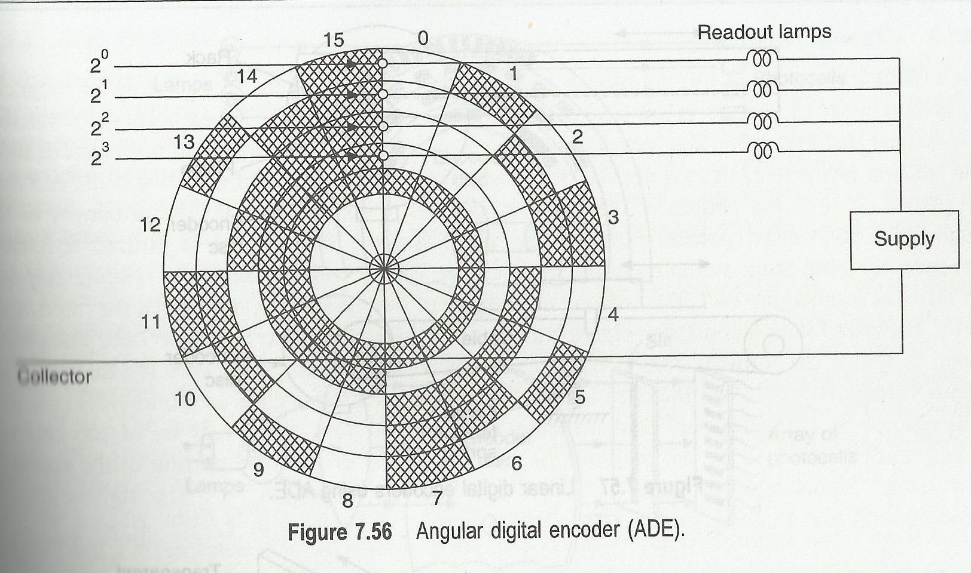
Transducers
Figure 7.55 Linear digital encoder (LDE).

Slide 99
Transducers
The disadvantages of brush pick-ups are normally associated with brush contact, brush bounce, and brush friction. Due to wear of brushes and contact surface of the encoder, life of the encoder is reduced. Also, arcing as brushes move across segments and mechanical vibrations are some of the problems in operation. The scales and discs shown in Figures 7.55 and 7.56 are encoders providing digital outputs in four bits. The angular digital encoder of Figure 7.56 is also known as shaft angle encoder and is normally meant for a total angular displacement of 360". Both the encoders shown are absolute encoders. Discs with up to 10 tracks each, having a resolution of 1 in 1024 are available. However, by using more than one disc and having internal gearing, overall resolutions up to 1 in 10⁵ can be obtained.

Slide 100
Transducers
Linear digital encoders (LDE) may also he obtained by converting linear motion into rotary motion through a rack and pinion or some such arrangement and using the shaft-angle encoders. The accuracy of these systems depends on the linearity of the linear-to-rotary converter. Simple arrangements using a pulley or a cable are shown in Figure 7.57. With all such systems, the precision of the mechanical components sets the limit on the accuracy of measurement.
Incremental encoders are single track discs or scales provided with alternating conducting and nonconducting areas as shown in Figure 7.58. All incremental encoders are .designed to generate a fixed number of pulses for each unit of angular or linear displacement of the encoder. The accuracy thus depends largely on the encoder disc or scale and the associated mechanical assembly used. The sensing systems for the incremental encoder may be the same as those adopted for the absolute encoders. Incremental encoders are used along with suitable signal processing circuits to count the. pulses generated by the encoder and convert the same into a digital output in the required code. All incremental encoders have to indicate the datum point to the signal processing circuits. The direction of motion must be sensed and used to provide the corresponding output.

Slide 101
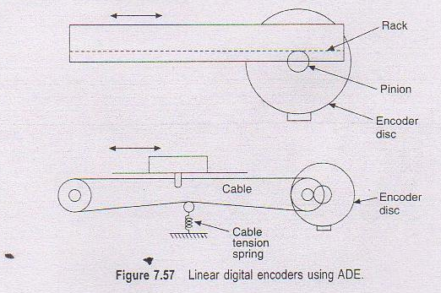
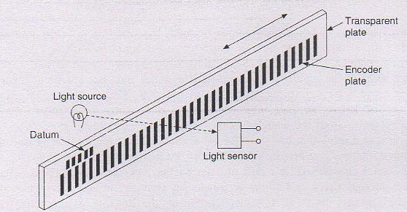
Transducers
Figure 7.58 Incremental digital encoder.
Figure 7.58 Incremental digital encoder

Slide 102
Transducers
Optical Encoders
The majority of shaft-angle encoders use noncontacting type sensing systems so as to make the measurements free from the problems of the brush contact, stated above. Optical encoders use optical and photoelectric sensing systems. The linear and aqgular encoders have a pattern of transparent and opaque areas corresponding to the conducting and nonconducting areas respectively of the contacting brush type. The sensing system consists of light sources, each provided with a focusing lens and an equal number of photoelectric devices, and receiving the light beam from its corresponding light source. The light sources are kept on one side and the photosensors on the other side of the encoder as shown in Figure 7.59(a). The sharpness of focusing and the special techniques adopted in the manufacture of the encoders have enabled achievement of an accuracy of better than 1 in 10⁸. Most of the optical encoders are produced

Slide 103
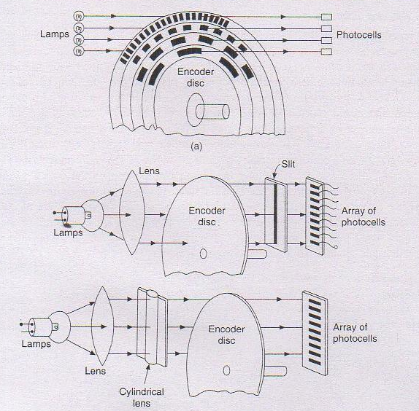
Figure 7.59 (a) Optical encoder; (b) arrangement of light sources and photosensors.
Transducers

Slide 104
Transducers
photographically, using a contact printing method from a master disc or scale, accurately machined to the requirements. The transition between a transparent and an opaque area must be sharp and well defined so that there is less noise in the sensors during the transition between the logic '0' and and sure decision. In this respect, optical encoders are specially favoured for application in high-accuracy systems.
Instead of having a large number of light sources, a single lamp and a lens is used as shown in Figure 7.59(b) to flood the encoder on one side. while the sensors receive light through a narrow slit located accurately with respect to the reference line. Alternatively, a cylindrical lens produces a single line beam which is so projected on to the reference line of the disc as to be incident on the sensors, after passing through the disc. Using a fine filament lamp, up to 5000 bits can be detected on discs of about 15 cm diameter. The silicon type photovoltaic cells, developing an output voltage of 20-40 my in a load resistor of 10 k0., are used as sensors. Amplifiers and other processing circuits develop the logic level sienals in required code format. Light-emitting diodes (LED) may be used instead of filament lamps but their light output efficiency is far less than that of filament lamps. LEDs have longer life and greater immunity against mechanical disturbances.

Slide 105
Transducers
Magnetic Encoders
The conducting areas of the contacting type encoders are replaced by a coating of magnetic material powder as is done in the case of magnetic tape, or it may be raised portions of suitably magnetized material while non-conducting portions are at a lower level with no magnetization. The sensing heads in each case consist of toroidal cores, each provided with two coils, and they are placed close to the pattern of the encoder, but not in contact with it. The proximity of the magnetized and raised portion saturates the core, and the coil system is utilized to enable detection by generating suitable output signals. One of the coils is known as reading coil and the other as interrogate coil. The reading coil develops output signals. only when the interrogate coil is energized with a constant voltage signal of 200 kHz, as shown in Figure 7.60. The output signal is low if the toroidal core is over the magnetized portion. as the core is saturated. The output voltage is high when the core is over the nonmagnetized portion as the toroidal core and coils operate as a transformer. Thus the output voltages of the reading coil are of 200 kHz but of aziplitudes governed by4he presence or absence of the magnetized portion of the encoder. Low output signal signifies logic level '0' and high output signal. '1'. The signals require demodulation and shaping so as to be distinct in their status as 0 or I.

Slide 106
Transducers

Slide 107
Transducers
Magnetic encoders are seen to be more complex than the contacting type or the optical encoders. But they are more reliable in operation than the contacting-type encoders.
When used as an incremental encoder, a series of pulses are produced which are added and indicated by an external binary counter. The resolution of the encoder is limited by the gap length of the toroidal core head, which may typically be 0.01 mm. For sensing direction of motion, four heads are arranged to read consecutively phased signals that are decoded by external logic circuits to provide 'clockwise' pulses on one output line and 'anticlockwise' pulses on a second output line. A reversible counter integrates the total shaft rotation at any instant.

